Slide 1
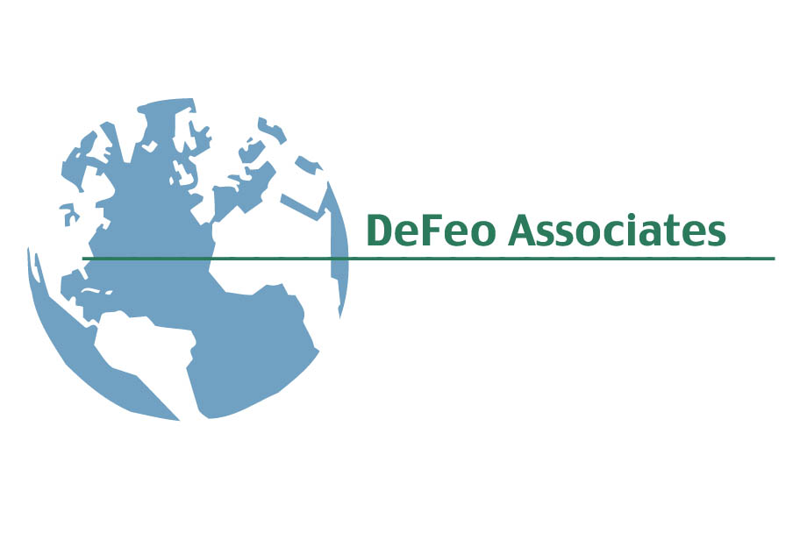
GOING GREEN’S UNEXPECTED
ADVANTAGE
May 3, 2016

Slide 2
Why Bother?
ECONOMIC PROSPERITY
TRIPLE
BOTTOM
LINE
ENVIRONMENTAL STEWARDSHIP
SOCIAL RESPONSIBILITY

Slide 3
ECONOMIC PROSPERITY
Taking actions that affect how businesses
turn a profit so that they will be able to continue for years to come.”
Adam Werbach, Strategy For Sustainability

Slide 4
Need I Say More?
PNC Bank Study Finds that LEED Certified Bank Branches yield
$461,300 more per employee than Non-Certified Branches.
The Relationship between Corporate Sustainability and Firm Financial Performance, Conlon and Glavas, 2012

Slide 5
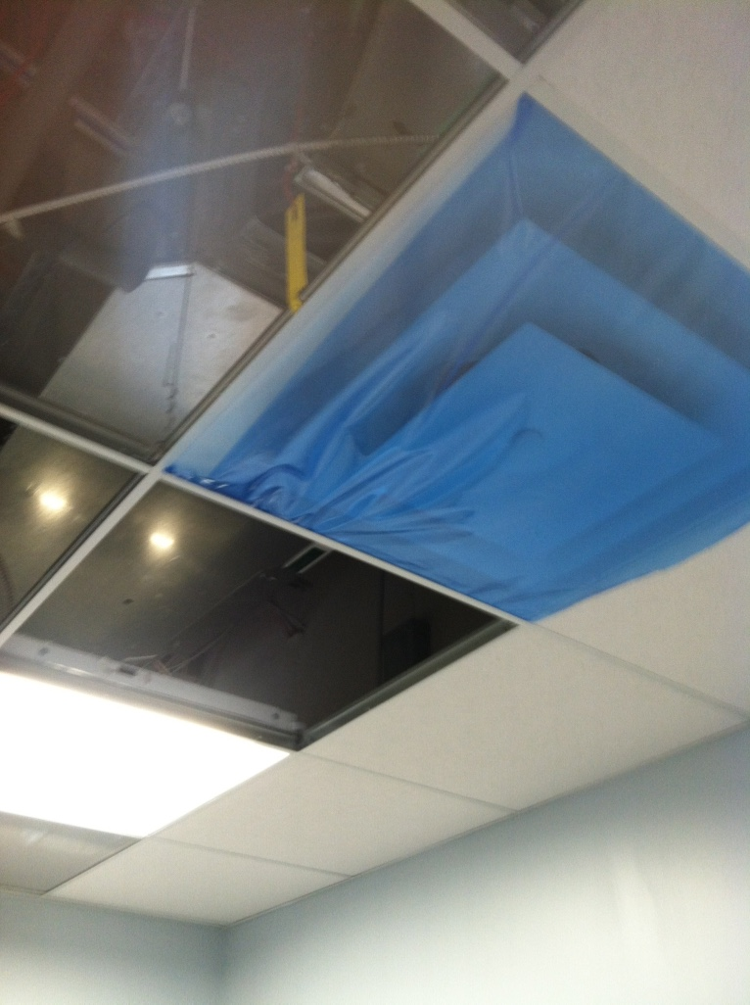
Thinking Globally and Acting Locally
Putting Neighborhoods First and Helping Local Communities Thrive
“Taking actions which
demonstrate that
other people matter.”
SOCIAL RESPONSIBILITY
“Taking actions that
protect and value
cultural diversity from
generation to generation.”
SOCIAL RESPONSIBILITY

Slide 6
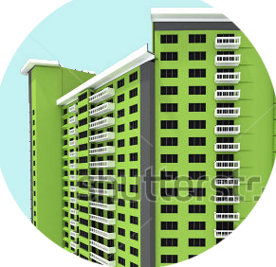
ENVIRONMENTAL STEWARDSHIP

Slide 7
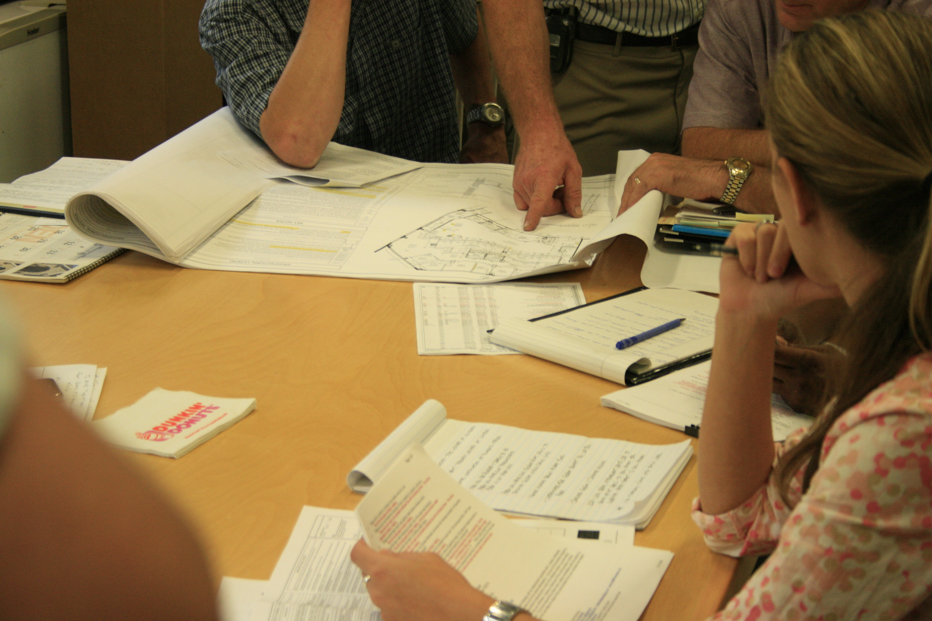
How to Begin the Process?

Slide 8
Measurement
Total Spent on Minority and Women
Owned Businesses (Millions)
Production (metric tons)
Product Shipped
Raw Materials from Recycled Sources
Waste (metric tons)
Generated Waste
Percent Recycled / Reused Waste Disposed Waste (metric tons) Waste Disposed
Solid Waste —Non-Hazardous Solid Waste —Hazardous Effluents (excluding water)
Air Emissions
Other
Energy Consumption (gigajoules)
Direct Greenhouse Gas Emissions (metric tons)
Total Greenhouse Gas Emissions (metric tons)
Water Consumption (cubic meters)
Met a goal of reducing its greenhouse gas emissions 25 percent from 2005 levels 14 years ahead of schedule.
NOx Emissions

Slide 9
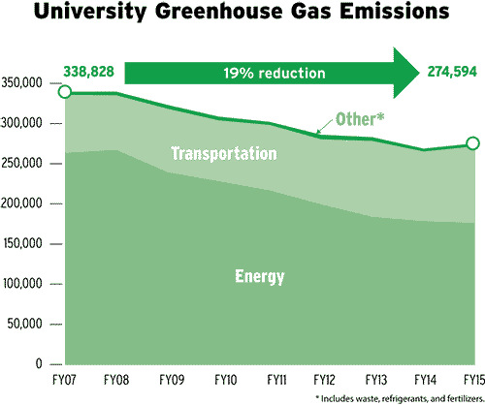
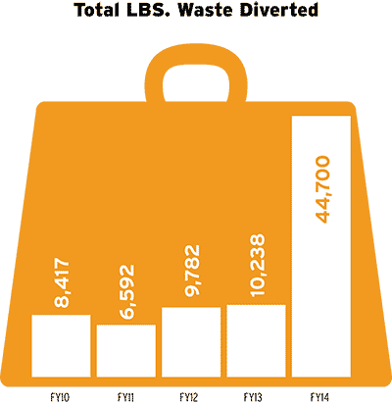
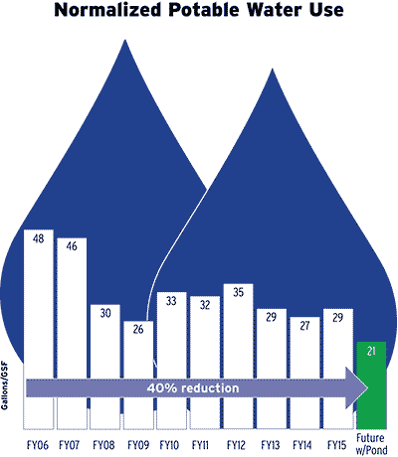

Slide 10
